Slide 1
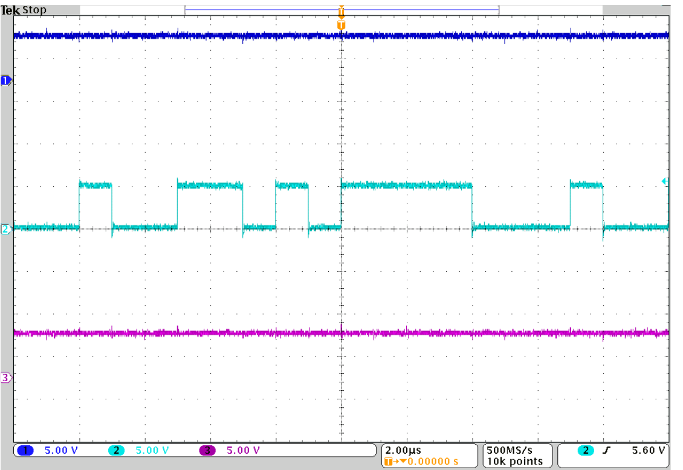
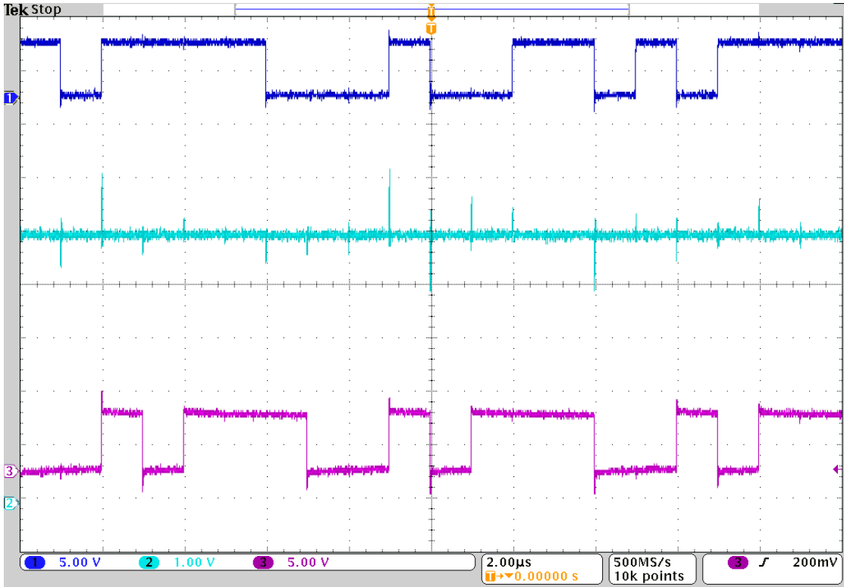
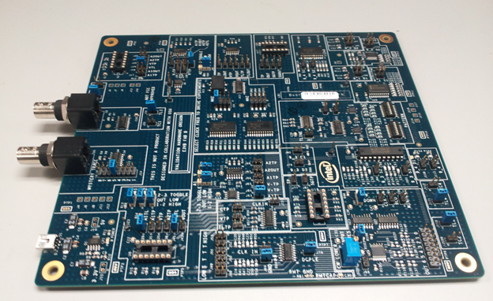
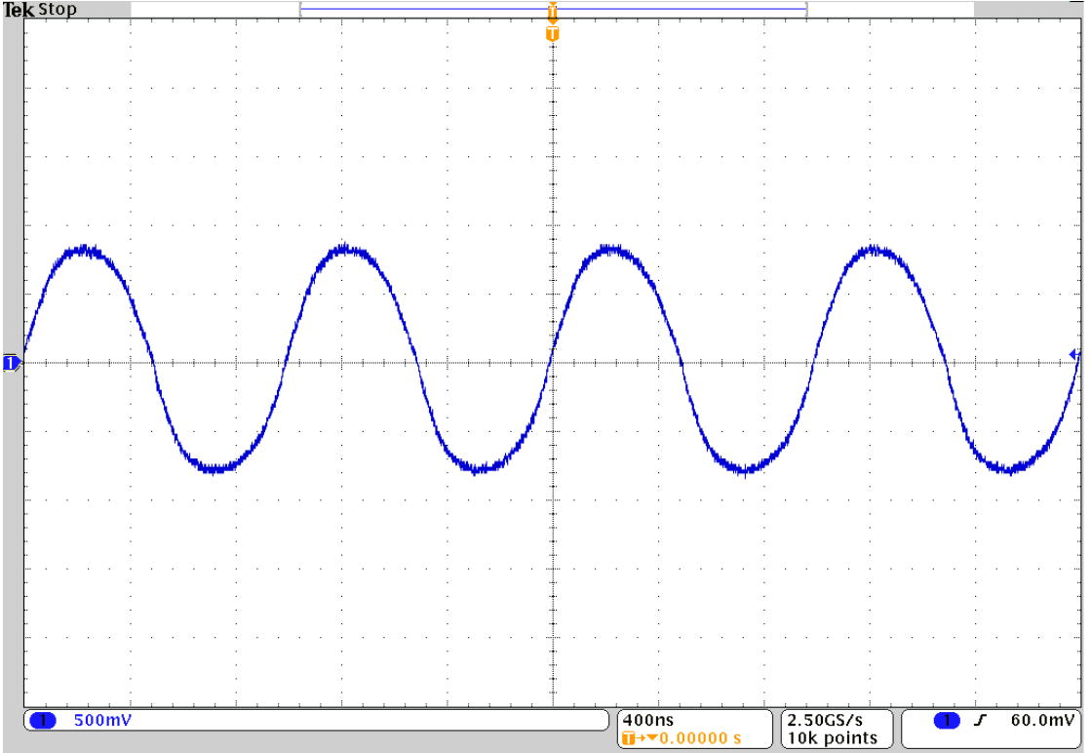
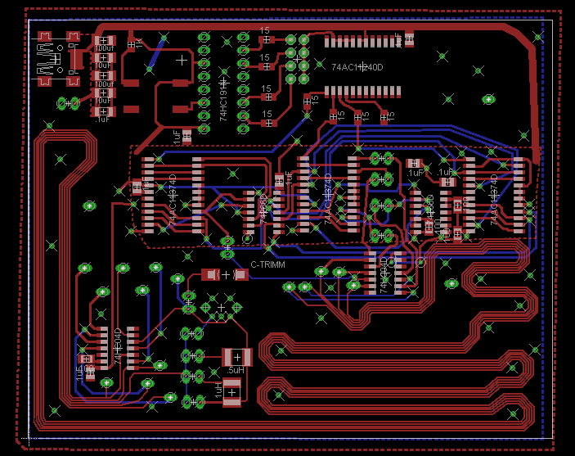
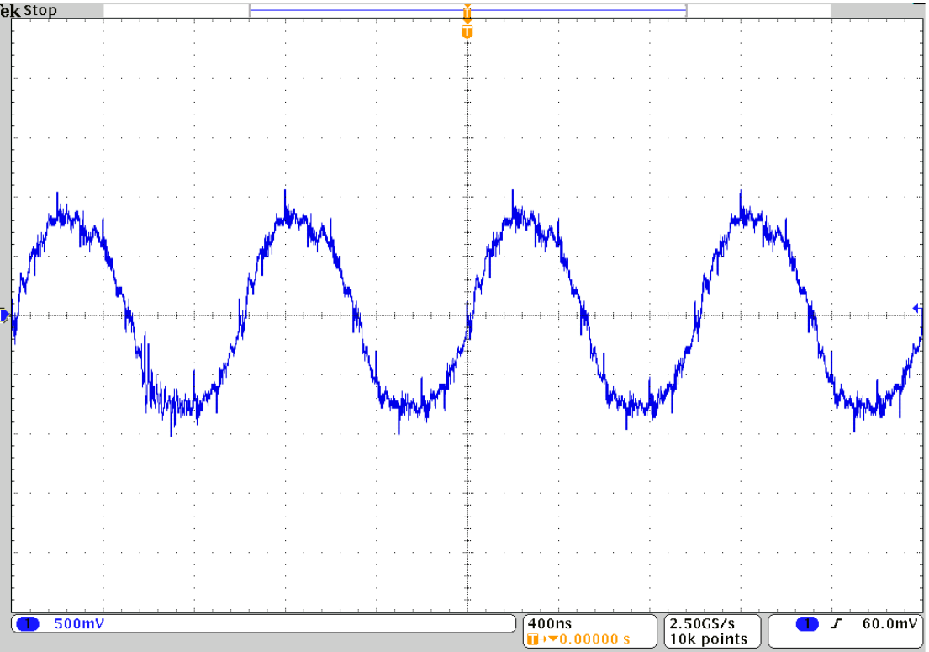
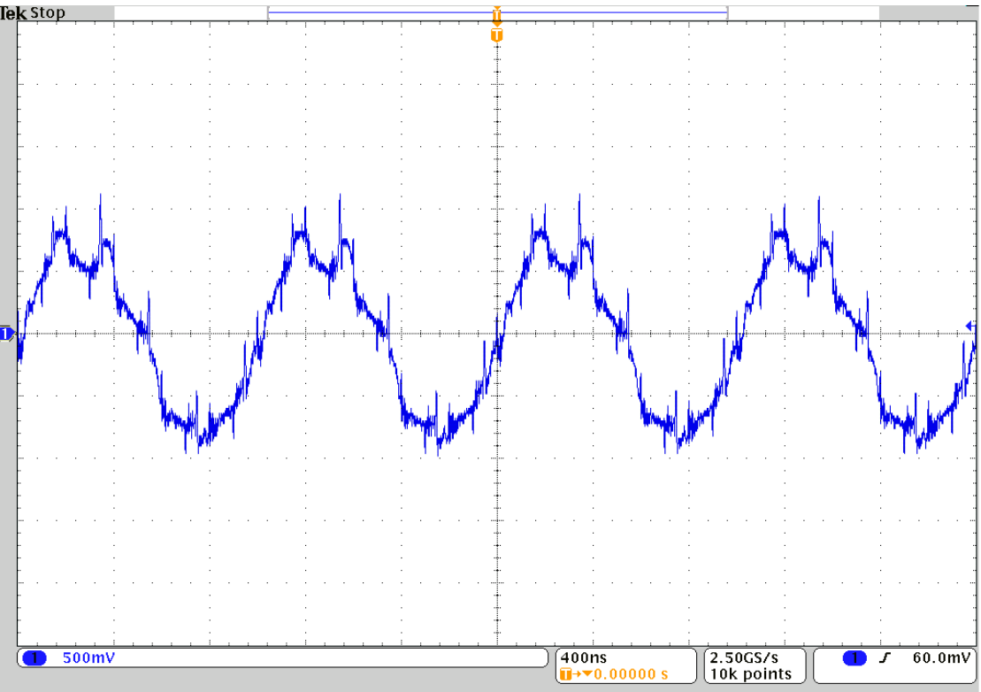

Signal Integrity Education
By: Travis Berger and Luis Santiago
Sponsor: Tony Muilenburg Advisor: Dr. James Morris
Background
Objective
Intersymbol Interference
In order for students and industry members to build an intuition for signal integrity issues, Intel developed an educational board to demonstrate these issues with a physical circuit. The Education Engagement Electrical Validation Board E3VB helps bridge the gap between theory learned in the classroom and common problems that occur while measuring circuits at the bench.
The objective of this capstone project was to help improve the E3VB by adding new experiments to the existing board. These experiments were required to work independently from the E3VB but still be capable of being added to the E3VB in a future revision. The experiments are designed to be interactive which helps students gain insight into signal integrity issues.
The goal of this experiment was to expand on the Intersymbol Interference and the Crosstalk experiments currently on the E3VB. This experiment uses four aggressor lines in parallel to show the effects of crosstalk on a nearby victim line. An LFSR was used to create a random patterns for each trace. This shows that the effect on the signal depends on both the previous symbols and the nearby signals.
Education Engagement
Electrical Validation Board
Mixed Signal Ground Technique
The goal of this experiment was to highlight signal integrity issues that occur with improper grounding when a board contains both analog and digital circuity. In mixed signal
applications the analog portion needs to be isolated from the digital section of the circuit. This experiment allows the students to measure the effects of different isolation techniques on the analog output signal.
Victim line with no aggressors
Transmission line with two
aggressor lines on each side
In order to induce Crosstalk the transmission lines were routed with only 6 mil of separation between them. Different series inductor values can be selected to intensify the intersymbol interference which helps the student build an intuition for the cause of these problems.
Analog signal without digital
Interference
Current Experiments
Crosstalk
Decoupling
Corners and Vias
Mystery Traces
Simultaneous Switching Noise
LCR Transmission Lines
Driver Circuit Comparison
Package Differences
Intersymbol Interference
Analog signal with isolated
GND planes
Analog signal with shared
return path
Department of Electrical and Computer Engineering

